Slide 1
Node Js

Slide 2
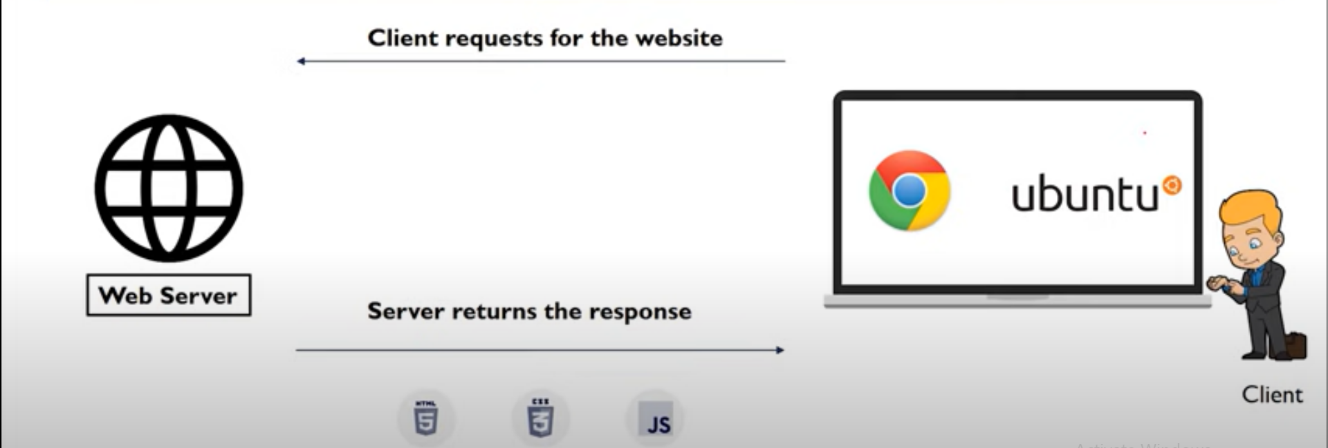

Slide 3
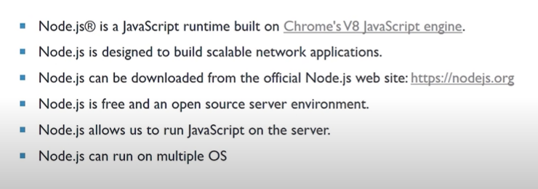

Slide 4
By default node js Code
const http = require('http');
const hostname = '127.0.0.1';
const port = 3000;
const server = http.createServer((req, res) => {
res.statusCode = 200;
res.setHeader('Content-Type', 'text/plain');
res.end('Hello World');
});
server.listen(port, hostname, () => {
console.log(`Server running at http://${hostname}:${port}/`);
});

Slide 5
const http = require('http');
const fs = require('fs');
Now we will write the line of code to read a file as follows-
const fileContent = fs.readFileSync('file name.html')
The final step is to make the server and serve the file. The code for the following is as follows-
const server = http.createServer((req, res)=>{
res.writeHead(200, {‘Content-type’ : ‘text/html’});
res.end(fileContent)
Till now we have made the server and now we will make this server listen on its port. Suppose we want to make it listen to port 80, so the code for this goes as follows-
server.listen(80, ‘127.0.0.1’, () => {
console.log(“Listening on port 80”);
});

Slide 6
The reason for listening to the server at port 80 was, we do not have to explicitly write anything else in the URL. For example, if we have taken 8000, then we have to explicitly write it on the URL to get the request back.

